Slide 1

MENTAL HEALTH IN THE MOVIES
BY: IKISHA HOLMES
PSY: 204-1370
PROFESSOR :
GAIL HUNTER

Slide 2

BACKGROUND ON SCAR
Scar grew up in the shadow of Mufasa
Overlooked
Resentment
Second best to Mufasa
Not considered for the throne
Jealousy
Pain
Truly believed he would be A better king
Being smarter
Less bound to tradition
More wisdom than Mufasa's brute strength

Slide 3


BACKGROUND ON SCAR
He planned to kill Mufasa & Simba
Simba’s birth sealed Scar’s fate as an outsider
Started to build up hate and bitterness towards Mufasa
Scar wanted revenge
His primary goal is to become king

Slide 4
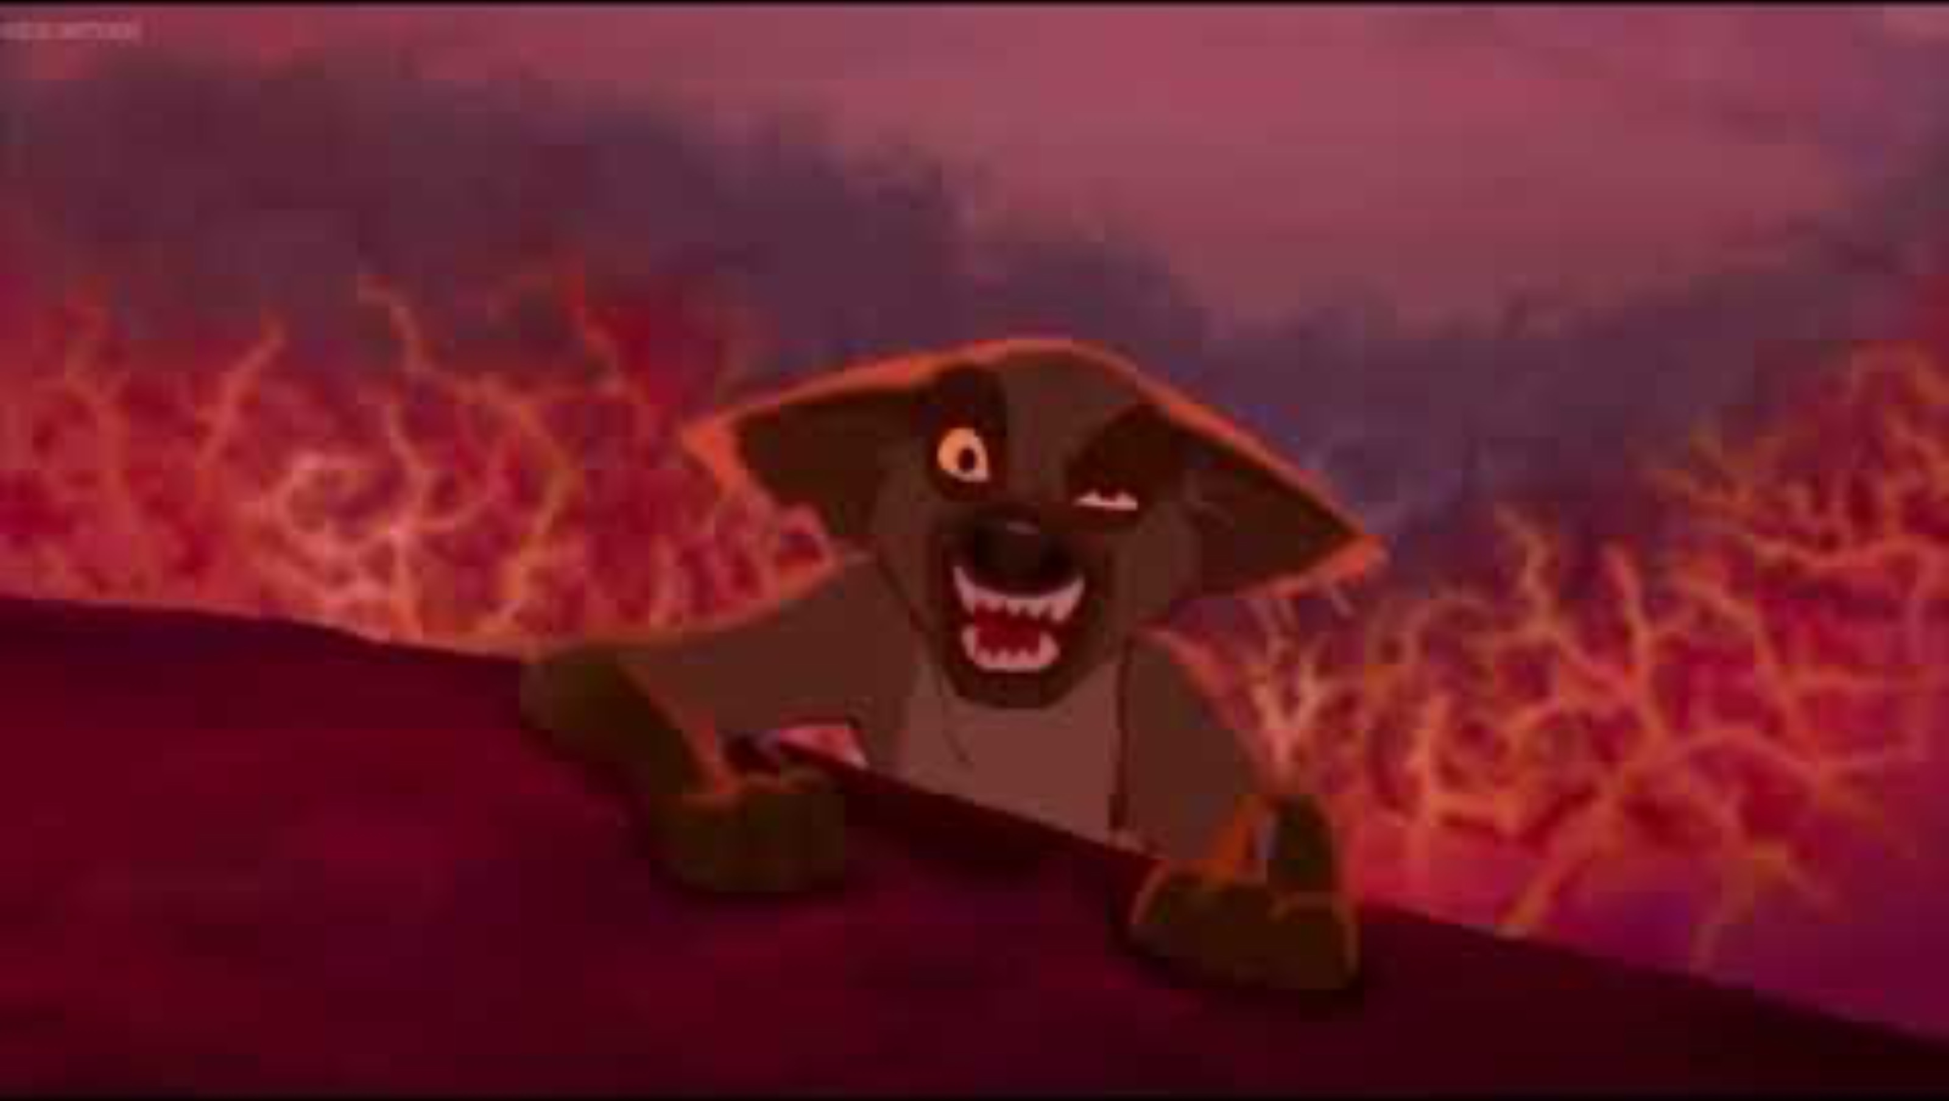
SCAR ORDERS THE HEYANES TO KILL SIMBA

Slide 5

SYMPTOMS:
Paranoid
Constant assumption that others are out to
Undermine him, even when they are not
Lack of empathy & blunted or performative
Mimics charm
He observes empathy but does not experience it
Chronic insecurity
Masked by arrogance
Struggles with feelings of deep inadequacy
He wants dominance
Persistent grudge
Almost obsessive
He doesn’t just hold onto the past, but he’s building A whole new identity around them
Delusional entitlement
Beliefs that the throne should be his
Actions are cold and calculated
He tricks other lions to gain power

Slide 6

DIAGNOSIS
NARCISSISTIC PERSONALITY DISORDER
ANTISOCIAL PERSONALITY DISORDER
PARARNOID PERSONILTY DISORDER
DARK PERSONALITY
NARCISSISTIC PERSONALITY DISORDER: centers around the individual;
However, with narcissistic personality disorder, individuals display a pattern of
grandiosity along with a lack of empathy for others. These proclamations may
also be fantasized to enhance their success or power. Oftentimes, they identify
themselves as “special” and will only interact with others of high status.
ANTISOCIAL PERSONALITY DISORDER: is the persistent pattern of disregard for, and violation of, the rights of others. This pattern of behavior begins in late childhood or early adolescence and continues throughout adulthood. A repetitive and persistent pattern of behaviors that violate the rights of others or major age-appropriate norms. Common behaviors of individuals with conduct disorder that go on to develop antisocial personality disorder are aggression toward people or animals, destruction of property, deceitfulness or theft, or serious violation of rules.
PARANOID PERSONALITY DISORDER: is characterized by a marked distrust or suspicion of others. Individuals with paranoid personality disorder often feel as though they have been deeply and irreversibly hurt by others, even though they lack evidence to support that these others intended to or did hurt them. Because of these persistent suspicions, they will doubt relationships that show true loyalty or trustworthiness
*Deceitfulness is another hallmark symptom of antisocial personality disorder, as individuals often lie repeatedly, generally to gain profit or pleasure*

Slide 7

SCAR THROWS MUFASA TO HIS DEATH

Slide 8

Treatment
PRIMARY: BUILDING INSIGHT THROUGH THERAPY
Consistent psychotherapy or psychodynamic therapy
Work on the root of his insecurities and anger issues
Work on his own identity
Change maladaptive thought patterns
Social skills to address interpersonal problems
SECONDARY: ADDRESSING HARMFUL BEHAVIORS
Cognitive Behavioral Therapy (CBT)
Lack of morality
Being aware of someone else's needs
Manipulation, impulsivity & distrust
Learning skills of not being in control or having power.
TERTIARY: REPAIRING RELATIONSHIPS & REBUILDING TRUST
Self–centered therapy, long-term, will help with fostering genuine empathy and accountability
Repairing rational damage
Family therapy
        MEDICATIONS:
Valproate Or Lamotrigine
Helps with emotional regulation, irritability, rage, & cold detachment
Quetiapine Or Risperidone
Helps with mistrust & suspicion
Sertraline Or Fluoxetine (SSRIs)
Helps with obsessive thinking, rage & ego

Slide 9

Final Thoughts
These disorders often go unseen because, on the surface, people might seem confident, guarded, or tough—but underneath, there’s usually a deep pattern of pain, fear, or disconnection.
Narcissistic Personality Disorder isn’t just about vanity—it’s rooted in fragile self-esteem, where self-worth depends almost entirely on external validation.
Paranoid Personality Disorder creates a lens through which the world constantly feels threatening, even without proof. Relationships become nearly impossible when trust is always out of reach.
Antisocial Personality Disorder often comes with a long history of disregard for others, but behind the behavior, there’s usually a story of early trauma, neglect, or emotional detachment.
These aren’t easy disorders to treat, but change is possible with time, compassion, and the right support. It’s slow work, but healing starts with being seen and understood, not judged.

Slide 10

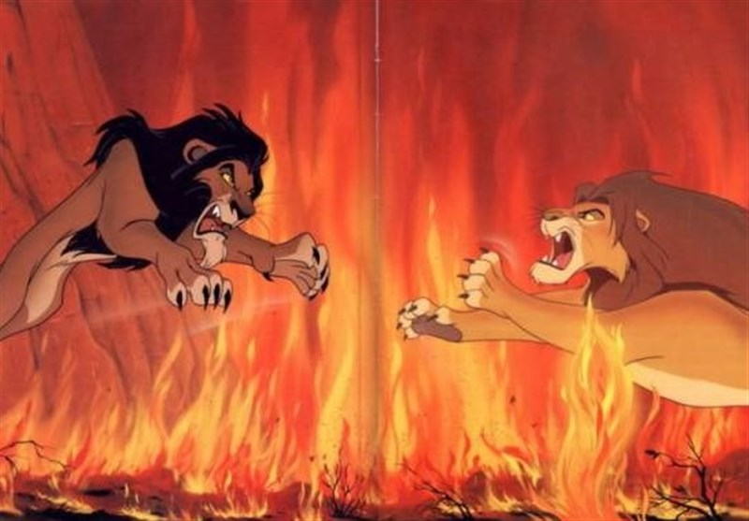
REFERENCES:
Bridley, A., & Daffin, L. W., Jr. (2020). Fundamentals of psychological disorders (3rd ed.).
https://nobaproject.com/textbooks/fundamentals-of-psychological-disorders
Cherry, K. (2023, May 2). How to recognize a malignant narcissist. Verywell Mind.
https://www.verywellmind.com/how-to-recognize-a-malignant-narcissist-4164528
Healthline. (2020, December 11). Malignant narcissism: Traits, causes, and how to cope.
https://www.healthline.com/health/malignant-narcissism
Mayo Clinic. (n.d.). Personality disorders. Mayo Clinic. https://www.mayoclinic.org/diseases-conditions/personality-disorders/symptoms-causes/syc-20350442
Raypole, C. (2022, October 14). What is malignant narcissism? Verywell Health. https://www.verywellhealth.com/malignant-narcissism-5214553
Talkspace. (n.d.). What is malignant narcissism? Talkspace. https://www.talkspace.com/mental-health/conditions/narcissistic-personality-disorder/types/malignant-narcissism/

