Slide 1
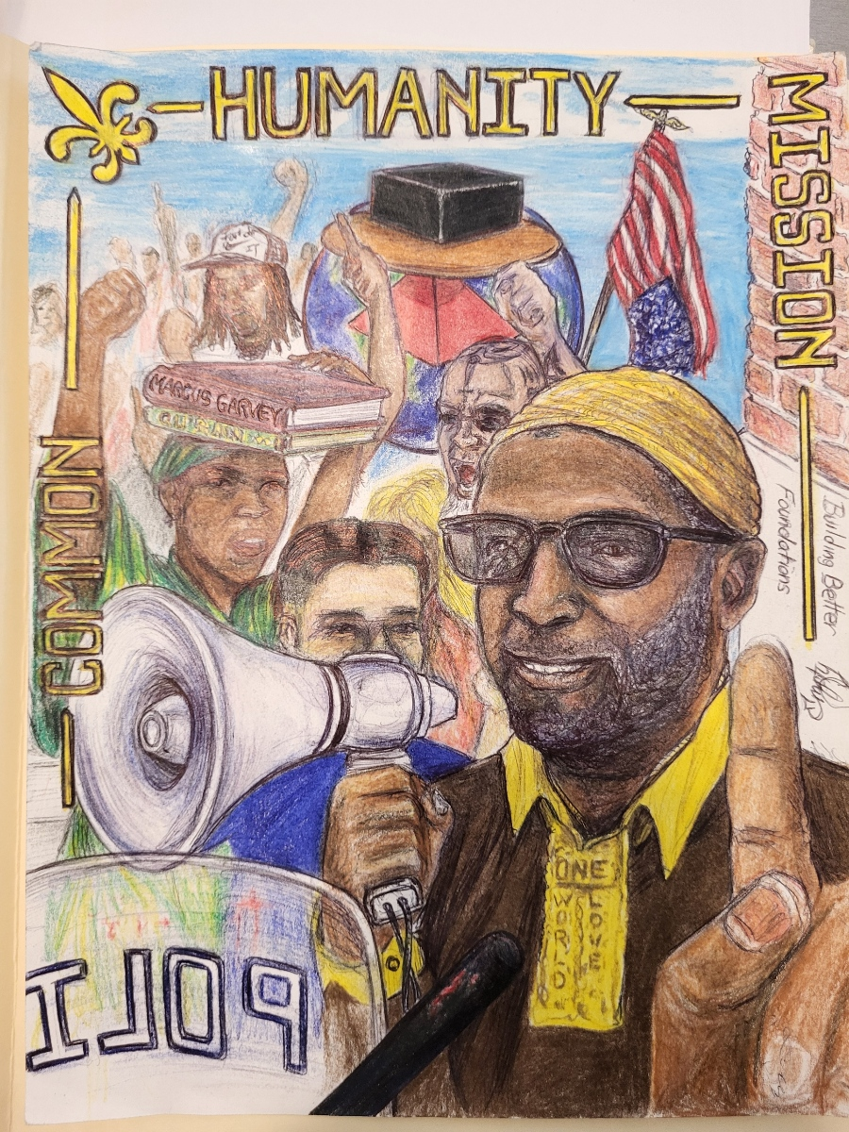
Malcolm X: An Abnormal Psychology Perspective
Maladaptive Schemas, Personal Transformation & Clinical Insight
Presented for Rev. Mwalimu Kevin Patrick

Slide 2

Introduction
• Overview of Malcolm X’s life: from trauma to transformation.
• Focus: Maladaptive schemas, psychological development, and spiritual evolution.
"A man's development is determined by how much of his past he can transform into a creative force." – Freud

Slide 3
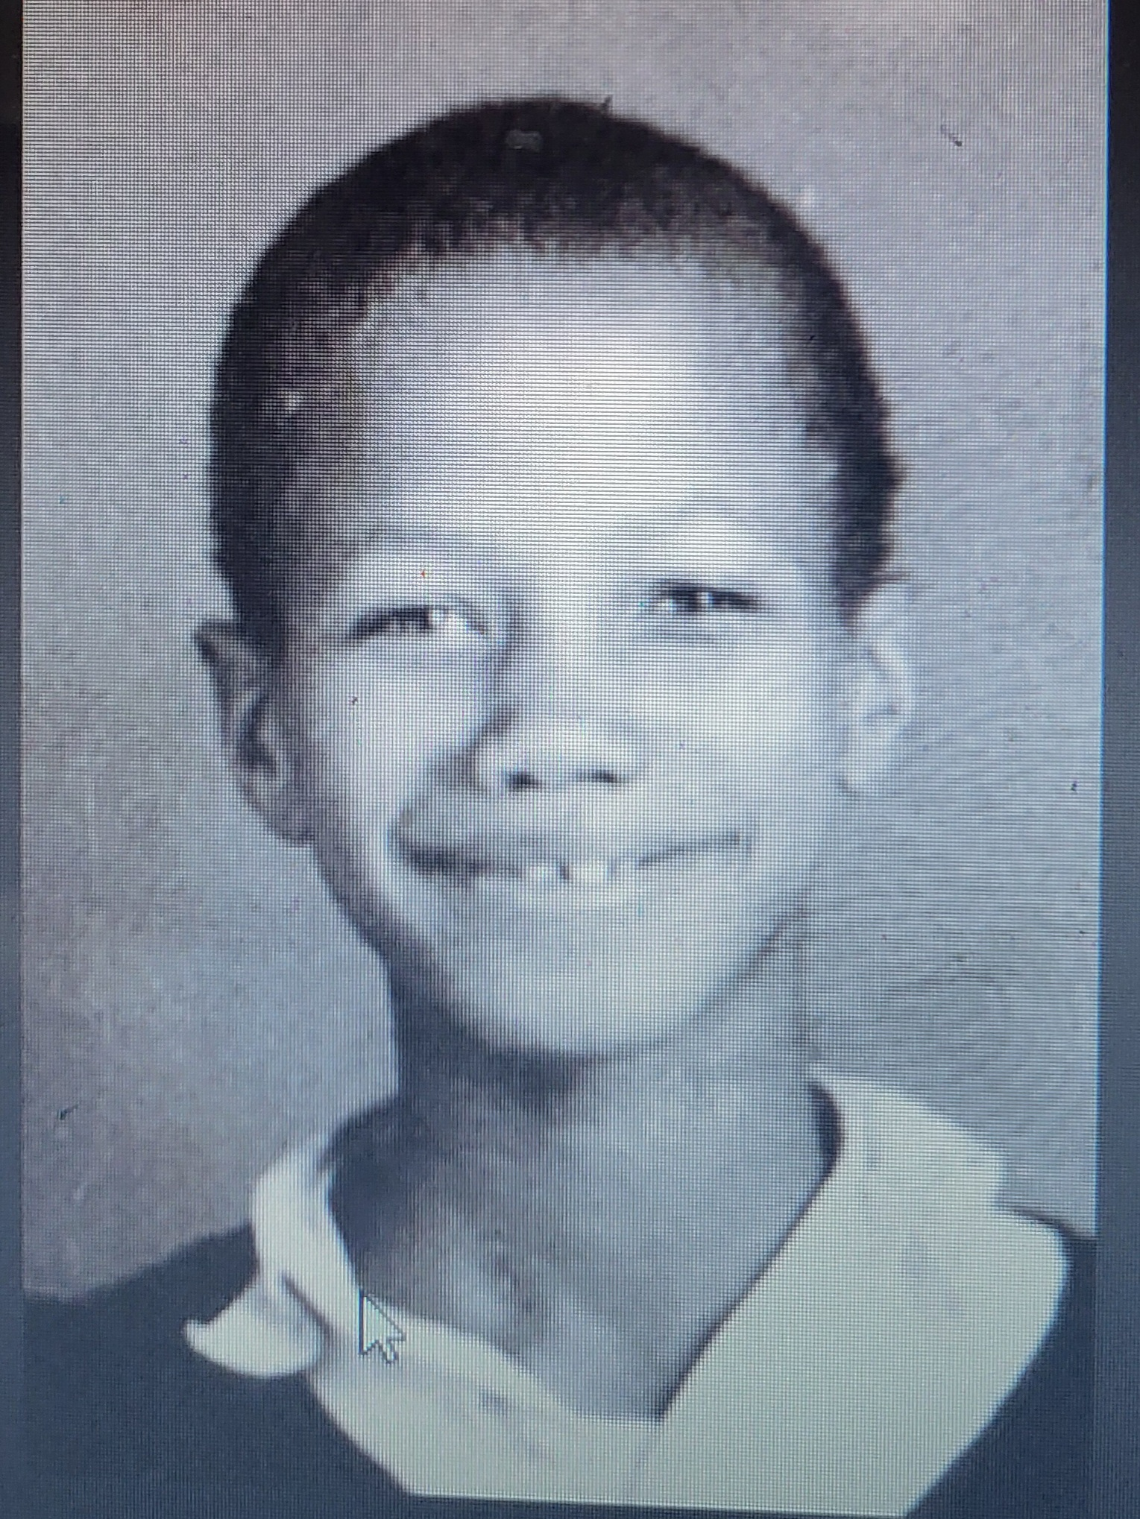
Early Trauma and Personality Formation
• Father's death, mother institutionalized → Abandonment schema.
• Foster care → Mistrust/Abuse schema.
• Freud: Ego mediates unresolved trauma. Also unmet emotional and psychological needs.
Notes:
Such as safety and security, connection and belonging, autonomy and control, acceptance and validation, self esteem and competence, attention and care, consequences such as emotional deregulation, relationship problems, low sell esteem, mental health issues, developmental trauma, repetition of traumatic patterns, and stagnation and lack of motivation.

Slide 4

Maladaptive Schemas and Early Identity
• Internalization of inferiority and anger.
• Defectiveness/Shame & Alienation schemas.
• Carl Rogers: 'The curious paradox is that when I accept myself just as I am, then I can change.'
Notes:
That which hinders effective functioning that paradox plays out even when our thinking is challenged and well resultsto emotional reasoning seeing things in unrealistic terms

Slide 5

Criminal Behavior and False Self
• Street identity masks deeper emotional wounds.
• Gestalt: Fragmented self lacking integration.
• Freud: Projection and sublimation used defensively.

Slide 6

Prison as a Turning Point
• Incarceration = self-education and religious awakening.
• Ellis (REBT): Change begins by disputing irrational beliefs.
"People are not disturbed by things, but by the views they take of them." – Ellis
Notes:
Cognitive dissonance the psychological discomfort or even tension experienced when individual holds conflicting beliefs, values or attitudes or when their behavior contradicts there beliefs leading to a desire to reduce that discomfort.

Slide 7
New Beliefs, Cognitive Restructuring
• Adoption of Islam restructured identity.
• Freud: Sublimation of aggression into purpose.
• Ellis: Rational beliefs replace maladaptive thoughts.

Slide 8
Conflict with Nation of Islam
• Betrayal = schema reactivation (abandonment).
• Gestalt: Disowned parts resurface.
• Rogers: Incongruence causes emotional distress.

Slide 9
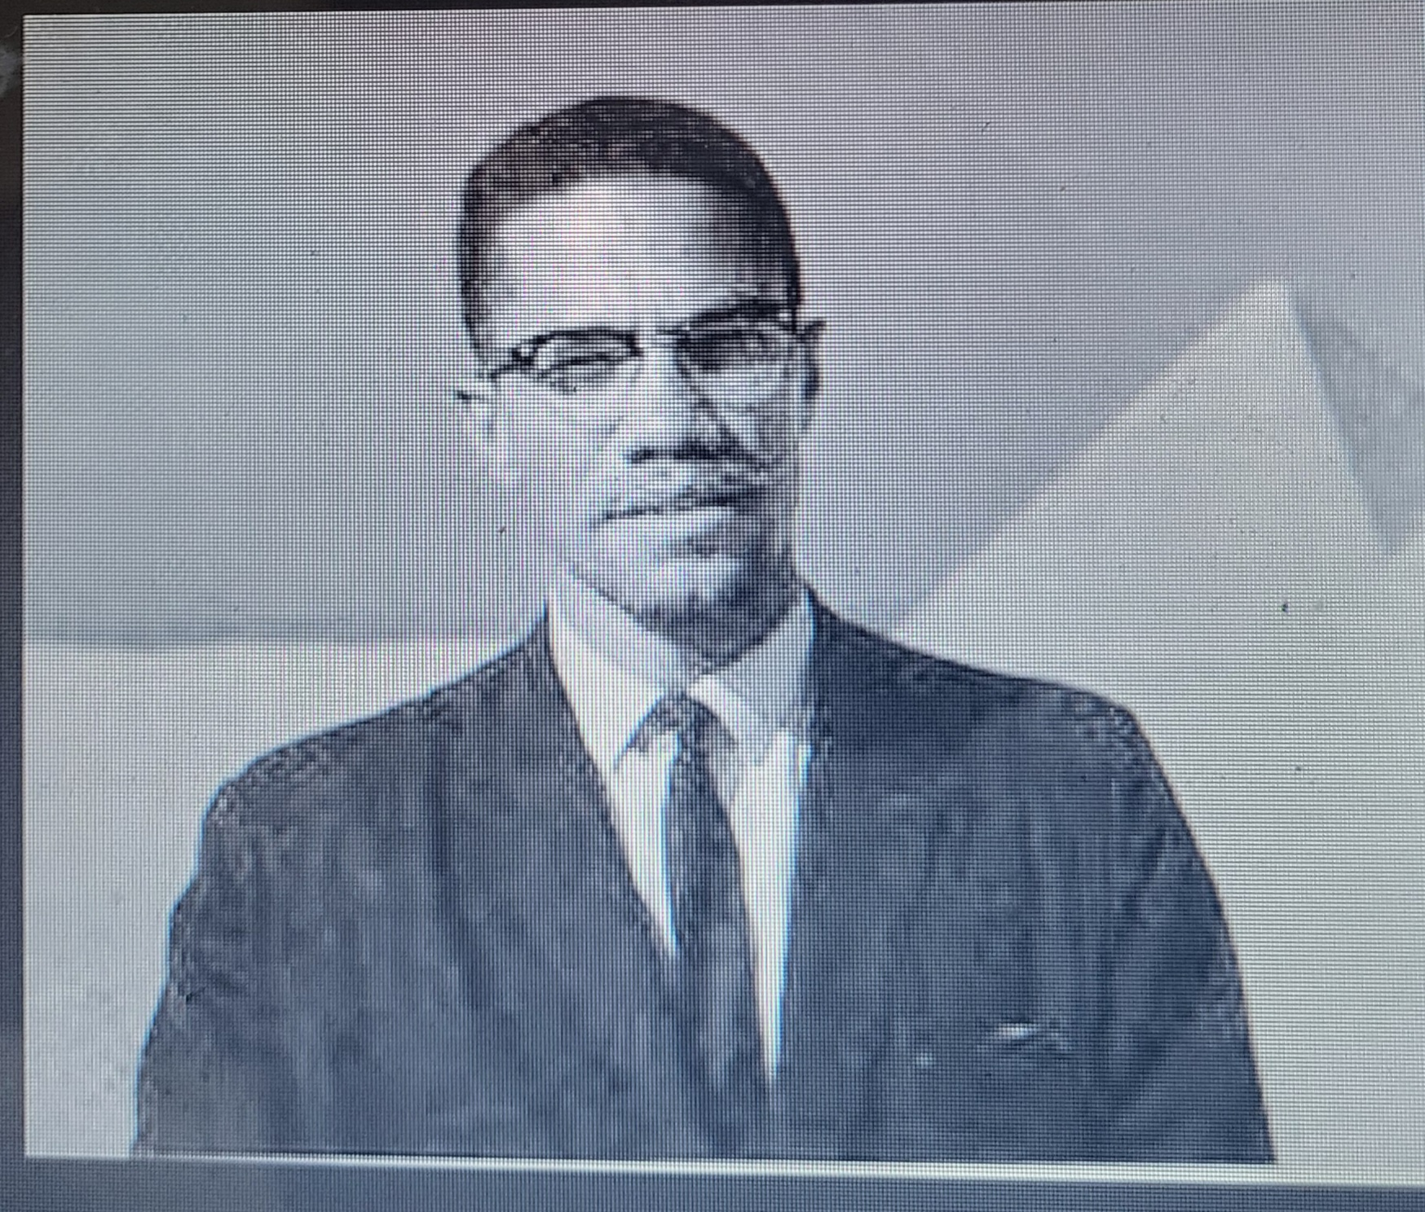
Pilgrimage and Healing
• Mecca: realization of universal brotherhood.
• Rogers: Self-actualization via unconditional regard.
• Gestalt: Integration of whole self.

Slide 10
Rev. Kevin Patrick’s Insights
1. Redemption as Purpose – Healing restores self-worth.
2. Psychological Resurrection – Malcolm evolved from disorder to discipline.
3. Social Learning Disabilities – Disconnected maturity reconnected.

Slide 11
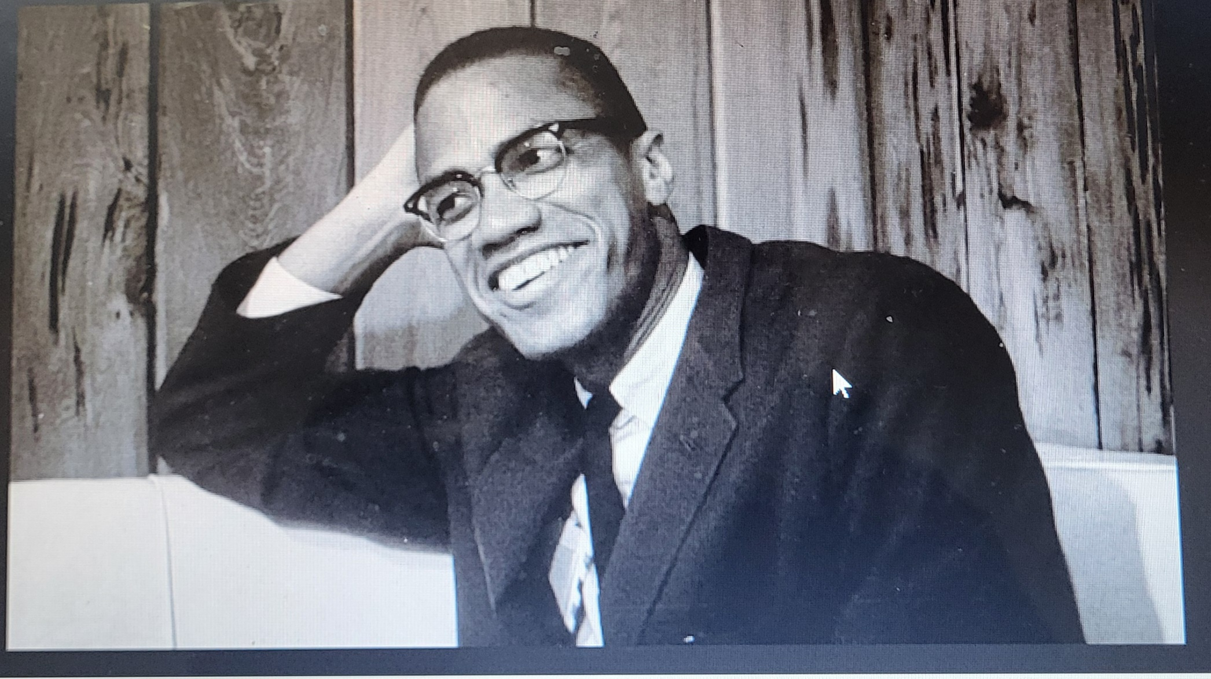
Conclusion & Reflection
• Malcolm X's life is a journey of psychological, social, and spiritual rebirth.
• Demonstrates schema healing, identity transformation, and resilience.
"Change occurs when one becomes what he is, not when he tries to become what he is not." – Beisser
Notes:
Arnold R Beisser Clinical Professor of Psychiatry at UCLA, a Life Fellow of the American Psychiatric Association, and a recipient of its Gold Achievement Award

